Slide 1
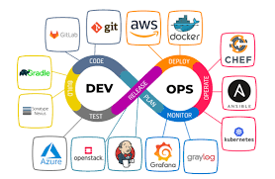
Final Project DevOps
Kubernetes and CI/CD Implementation
Presentation on Kubernetes and CI/CD Implementation
By Muhamed Joulani

Slide 2


Thank You Letter
I would like to extend my heartfelt thanks to the following individuals and organizations who have supported me throughout this project:
My wife and family: For their unwavering support and understanding.
Ministry of Employment: For providing the resources and opportunities to pursue this project.
Administration of the College Atech: For their continuous support and guidance.
Teacher Alexey Mihaylov: For his invaluable teaching and mentorship.
Student Abed Gzmawe: For his collaboration and assistance.

Slide 3
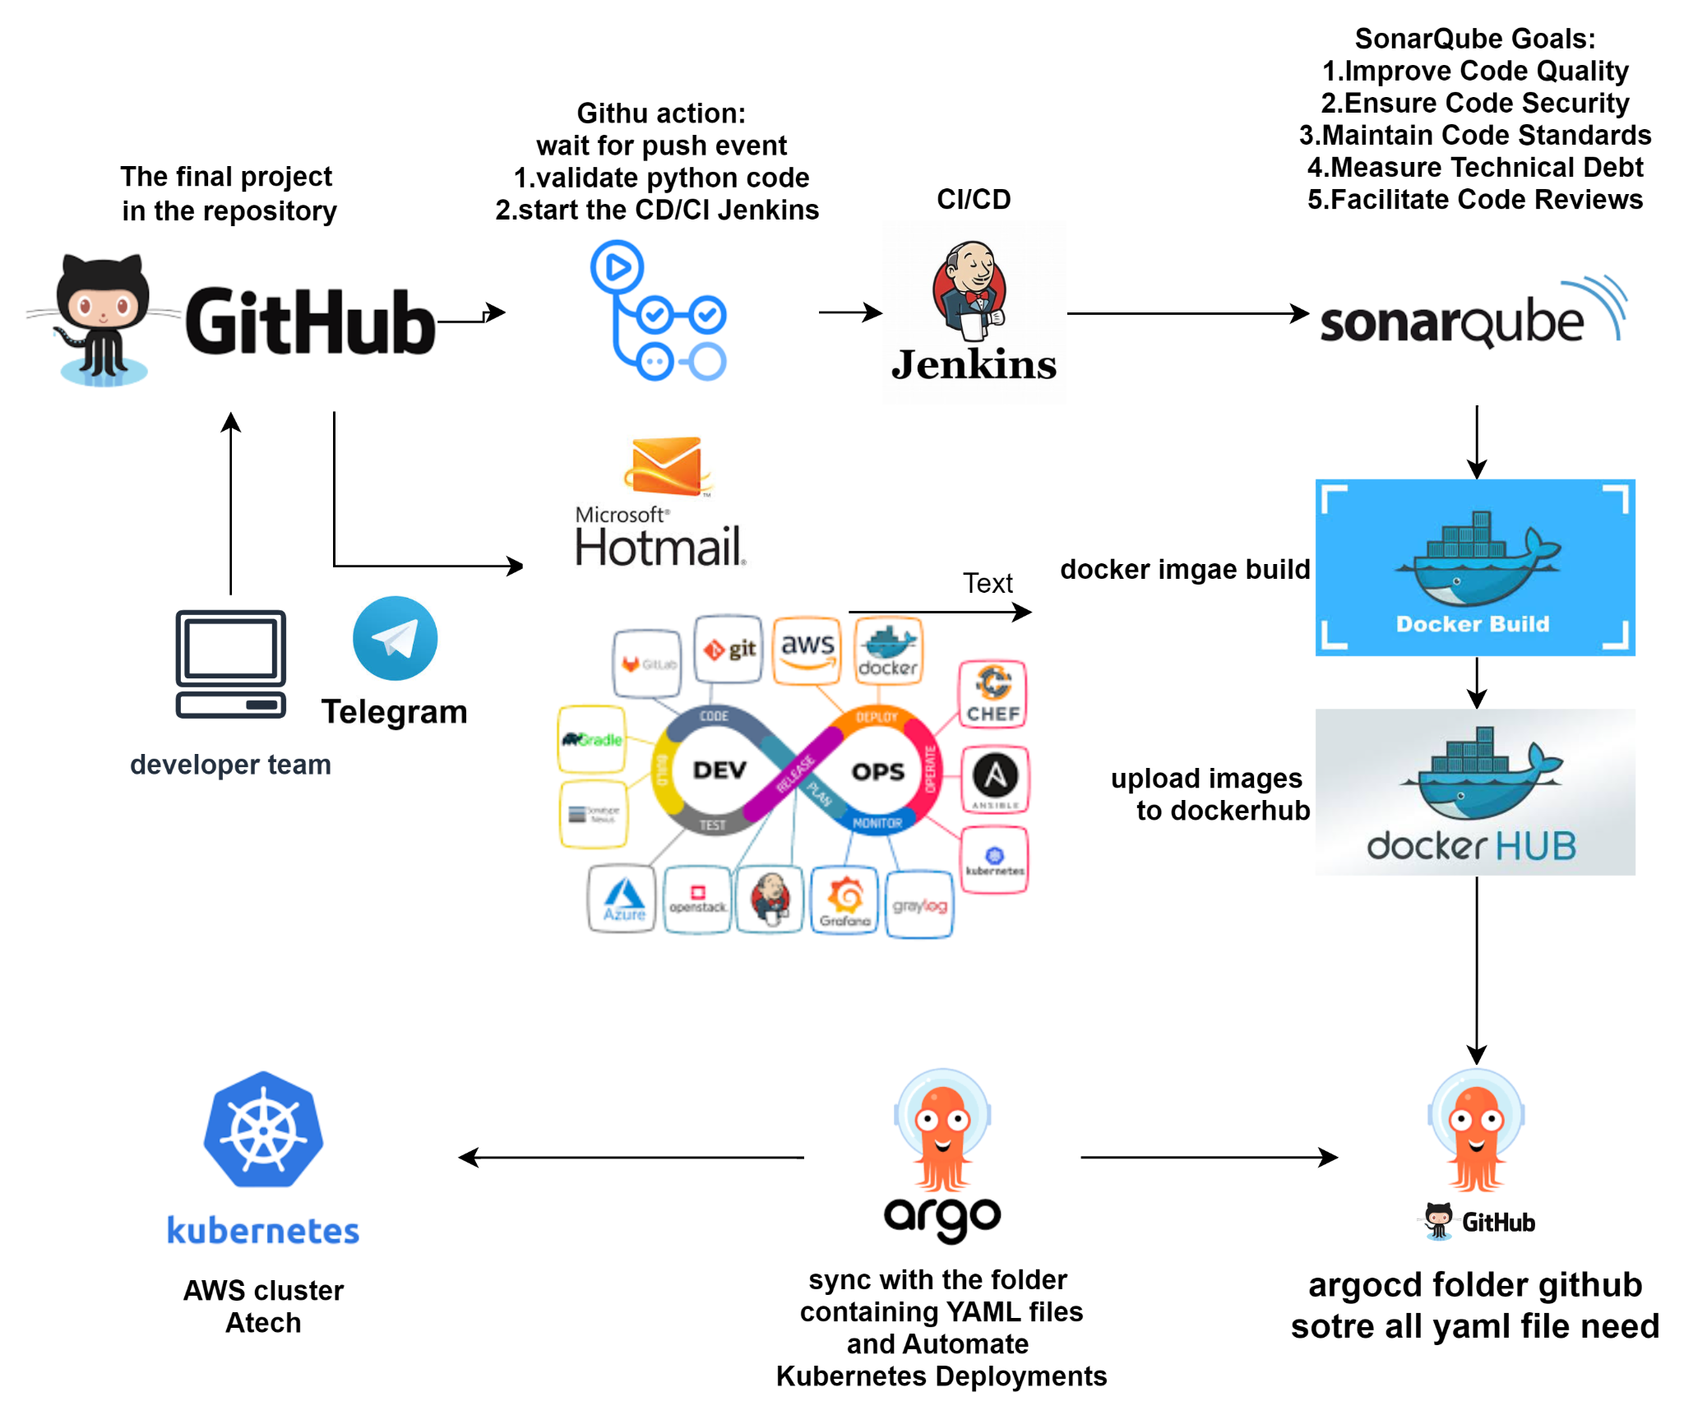
Project Diagram: click to open Diagram

Slide 4
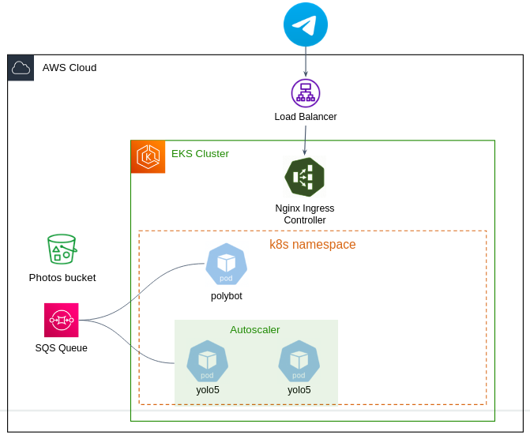
Project Cluster Atech Diagram: click to open Diagram

Slide 5
Project Objective
Content:
Designing and implementing a comprehensive CI/CD pipeline.
Deploying services in a microservices architecture within Kubernetes
Telegram Integration
Deploy and work with Prometheus and Grafana monitoring tool.

Slide 6
Preparations:
Content:
Installation Jenkins
Installation with Helm Prometheus and Gerfan
Authentication aws,Jenkins,...
Argocd up and running
Telegram bot up and running
https://argo-cd.atech-bot.click/
http://muh-grafan.atech-bot.click
http://muh-promethues.atech-bot.click:9090
http://52.201.178.63:3000 (Grafana)
http://52.201.178.63:9090/ (Prometheus)
http://100.27.108.130:8080/ (Jenkins)
http://52.20.17.126:9000 (SonarQube)

Slide 7
Service Guidelines:
High-level architecture of the service.
Source code repository setup.
Docker images storage.
YAML manifests creation for polybot and yolo5.
Configuration of liveness and readiness probes.
Resource requests and limits.
Autoscaling yolo5
Implementing full CI/CD pipeline Jenkins and GitHub Action.
Graceful termination handling.

Slide 8
Telegram Integration:
Content:
Configuring the Ingress object.
Performing TLS termination.
Creating a subdomain in Route53.

Slide 9
Service Monitoring:
Content:
Deploying Grafana and Prometheus using Helm chart.
Integrating Grafana with AWS Cluster Atech.
Building dashboards to display metrics.

Slide 10
Project Devpos Tools:
Content:
Monitoring Grafana and Prometheus .
CI/CD Jenkins and Github Action.
Argocd.
MobaXterm
Kubectl CLI
Aws CLI
Windows with wsl ubuntu
Git Bash
Draw.io
Postman
Lens

Slide 11
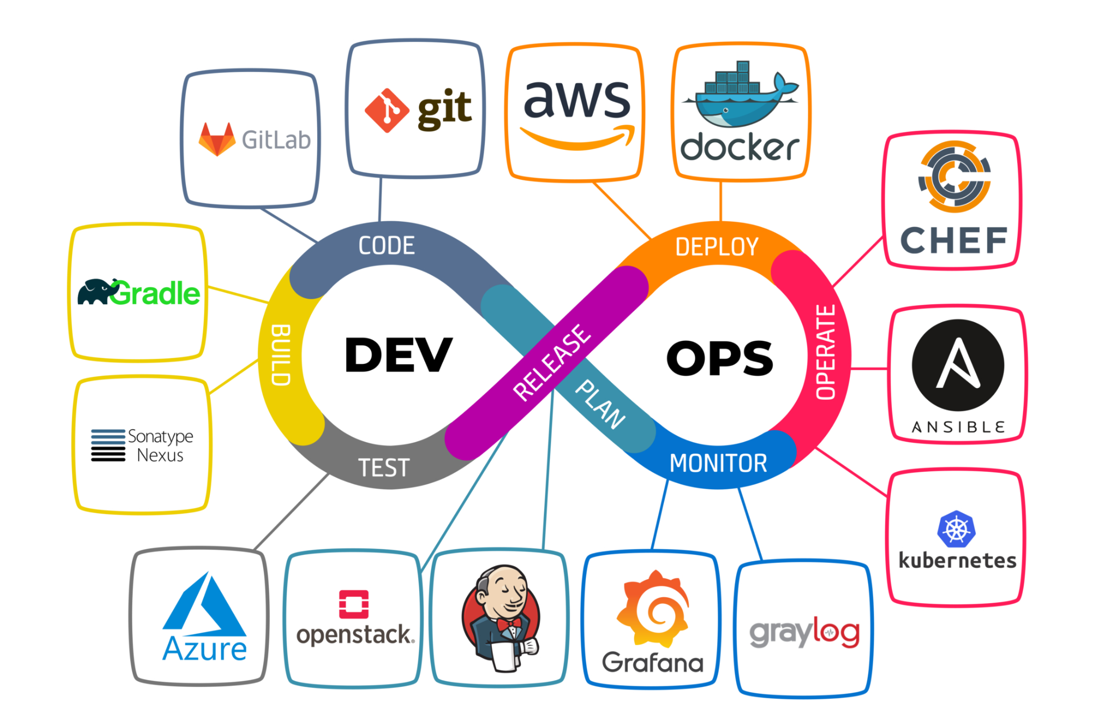
End of the Presentation
Thank all

